Slide 1
OPERATIONAL PLAN
Ryan White HIV/AIDS Program and Housing Opportunity for People Living with HIV/AIDS Housing Program
Data Integration
January 9, 2017

Slide 2
D.I.G Project Goals
Enact new policies and processes to support data exchange and analysis;
Create a bi-directional interface between the CAREWare and CaseWorthy systems;
Develop and implement a cross training curriculum to foster improved service delivery, data exchange and analysis;
Analyze comprehensive data to assess changes in health outcomes;
Document and disseminate challenges, lessons learned, best practices, and innovative models.
Improve health outcomes for persons living with HIV/AIDS and those prone to homelessness

Slide 3
Client Population
Ryan White Part A Hartford HIV population & Hartford HOPWA clients who receives services in:
Hartford County
Middlesex County
Tolland county.

Slide 4
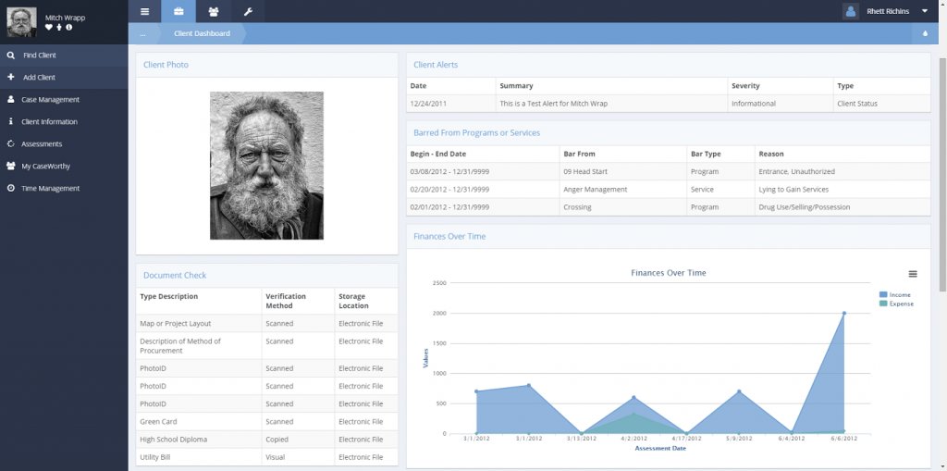
Data Systems
Ryan White CAREWare System (JPROG Inc.)
HOPWA CaseWorthy System (Nutmeg Consulting)

Slide 5
Key Partners
City of Hartford Ryan White and HOPWA recipient Offices
AIDS CT,
Connecticut Children’s Specialty Group,
Community Health Center Inc
Chrysalis Center,
Community Health Services Inc
Charter Oak Health Center,
Community Renewal Team,
Hartford Gay and Lesbian Health Collective,
Hands on Hartford,
Human Resource Agency of New Britain,
Latinos Community Services,
Mercy Housing and Shelter,
Rockville Hospital,
Hospital of Central Connecticut,
Hartford Hospital
Saint Francis Hospital,
St Phillips House,
University of Connecticut Health Center
Zezzo House

Slide 6
Data Integration Grant Steering Committee
Peta-Gaye Nembhard
Angelique Croasdale
John Merz
Melanie Alvarez
Lionel Rigler
Russ Cormier
Kate Bassett
Barbara Shaw
Sheryl Horowitz
Melissa Lebron
Danielle Warren-Diaz
Yolanda Potter
Shawn Lang
Catellia Casey
Abbie Kelly
Luna Jayna Hernandez
Michelle Jarvis
Ricardo Cruz

Slide 7
Data Elements

Slide 8
Interface
Bidirectional
Daily Imports/Exports of new data (if data is available)
CaseWorhy will export housing data
Housing status, veterans status, financial assessment, CM assignment etc
CAREWare will export Clinical and service Information into CaseWorthy
Medications, Labs, screenings, referrals, services, etc
Alert/messaging system that allows users to send communications between systems

Slide 9
Reporting
Performance Measurement
Gaps in Care;
Clients Prescribed HAART;
Retention in Care and;
Viral Load suppression.
Custom Reporting
demographics, service plan, housing data, referrals, utilization
HOPWA CAPER (Improved)
Ryan White RSR (Improved)

Slide 10
Client Flow Diagram
Current Ryan White and Housing Service Delivery System

Slide 13
Monitoring &Evaluation
By Sheryl Horowitz
Chief Research and Evaluation Officer
Connecticut Association for Human Services

Slide 14
Research Question 1. How have client housing, care, and treatment outcomes for HOPWA and RW clients changed since both programs' providers began accessing integrated client data? Are changes equitable ?
Data Source | Outcome Measures | RSR/CAPER element | Data Collection Intervals*
Sites’ integrated data systems | Housing Status: % of RW clients unstably housed (disaggregated by race) % of HOPWA clients unstably housed (disaggregated by race) % of consumers with joint RW and HOPWA needs who achieve both viral suppression (or are engaging in ART)and stable housing (including transitional or emergency) within 4 months of receipt of case management | RSR HousingStatusID Race/Ethnicity CAPER Housing Status Type of Residence/Living Situation Race/Ethnicity | Baseline, 6m, 12m
 | Retention in Care: % of RW and HOPWA clients who had at least one HIV medical care visit in each six-month period over the last 12 months, with a minimum of 60 days between medical visits(disaggregated by race) % of new HOPWA clients who had at least one HIV medical care visit in each six-month period over the last 12 months, with a minimum of 60 days between medical visits (disaggregated by race) | RSR ClientReportServiceVisits (ServiceID) ClientReportServiceDelivered (ServiceID) ClientReportAmbulatoryService (ServiceDate) Race/Ethnicity
 | ART Use: % of RW and HOPWA clients prescribed ART for the treatment of HIV over the previous 12 months (disaggregated by race) % of new HOPWA clients prescribed ART for the treatment of HIV over the previous 12 months(disaggregated by race) | RSR PrescribedArtID Race/Ethnicity
 | Viral suppression: % of RW and HOPWA clients with a viral load <200 copies/mL during the last test in the last 12 months(disaggregated by race) % of new HOPWA clients with a viral load <200 copies/mL during the last test in the last 12 months(disaggregated by race) | RSR ClientReportViralLoadTest (ViralLoadTest Count ServiceDate) Race/Ethnicity

Slide 15
Research Question 2: In what ways has Ryan White and HOPWA data integration changed client service coordination across Ryan White and HOPWA providers?
Data Source | Outcome Measures | RSR/CAPER element | Data Collection Intervals*
Sites’ integrated data systems | RW documentation of Housing Status: # sites for which RW recipient has implemented collection of HOPWA housing status % of RW clients with housing status updated by RW MCM at least once in the last six months | RSR HousingStatusID CAPER Housing Status Type of Residence/Living Situation | Baseline, 6m, 12m
 | Joint RW and HOPWA clients: • % of RW clients who are also HOPWA clients (have RW and HOPWA ID) # of RW clients who become new HOPWA clients # of RW and/or HOPWA clients with Gaps in Care | CAPER Personal ID Project Entry Date Hartford-Data Interface Custom Report
 | Coordination of new unstably housed RW clients: Average amount of time between date of entry of unstable client housing status into RW data system and date of HOPWA intake/enrollment Average amount of time between date of entry of unstable client housing status into RW data system and date of placement into stable housing Mean referrals/client/quarter (RW to housing services and HOPWA to RW) # Custom reports generated/site with RW and HOPWA variables | RSR HousingStatusID CAPER Housing Status Type of Residence/Living Situation Project Entry Date Destination Residential Move-In Date Referral type Custom Report Generation

Slide 16
Research Question 2: In what ways has Ryan White and HOPWA data integration changed client service coordination across Ryan White and HOPWA providers? (Cont’d)
RAND TA logs / Site progress reports | RW and HOPWA program coordination # of RW and HOPWA joint program coordination meetings # of RW and HOPWA joint trainings |  | 6m, 12m
RW and HOPWA leadership, staff, provider, and expert client qualitative interviews | Perceived process of service coordination under old vs. new system List and descriptions of perceived barriers and facilitators List and descriptions of perceived effects of data integration and service protocol on coordination and client outcomes |  | Yr 2 and Yr 3 annual site visits
Observation of provider use of the integrated data system | Ability to use integrated data system to coordinate client services % of RW providers with housing-needs consumers, who request HOPWA data fields and reports/quarter % of HOPWA providers, with HIV/AIDS – needs consumers, who request RW data fields and reports/quarter # of requests for additional fields or information within database % of staff with training who input data on a monthly basis |  | Yr 2 and Yr 3 annual site visits
Provider quantitative survey | Extent of use of the integrated data system Potential barriers to and facilitators of use (e.g., regarding training and positive and negative beliefs about the system). % Very Satisfied with training % of providers satisfied with data integration product and procedures |  | Yr 2 and Yr 3 annual site visits

Slide 17
Research Question 3: What specific aspects of data system changes (e.g., flags, alerts, provider-to-provider communication) have affected client housing, care, and treatment outcomes?
Data Source | Outcome Measures | RSR/CAPER element | Data Collection Intervals*
Sites’ integrated data system documentation: Codebooks/user manuals for RW and HOPWA data systems New data system functions (e.g., flags, alerts) | Number and type of new data elements in integrated data systems: New data fields for housing in RW data system and/or new data fields for care and treatment in HOPWA data system New provider referral or communication functions in data system Prompts to contact RW clients who are out of care Prompts to contact HOPWA clients who are out of care Prompts for RW providers to check housing information Prompts for HOPWA providers to check care and treatment outcomes |  | Baseline, 6m
RW and HOPWA leadership, staff, and provider qualitative interviews | Reported use of novel data elements and data system functions Perceived adequacy of training on data system and service coordination changes Perceived positive and negative aspects of use |  | Yr 2 and Yr 3 annual site visits
Client focus groups or surveys | Perceived change in quality of service Perceived change in personal and medical progress Perceived change in value of process |  | Yr 2 and Yr 3 annual site visits

Slide 18
Research Question 4: In terms of cost, what resources are required to implement and maintain data integration of Ryan White and HOPWA data systems?
Data Source | Outcome Measures | RSR/CAPER element | Data Collection Intervals*
Site invoices | Startup investment needed to launch the data integration Resources required to maintain the data integration Resources spent by categories of data integration activity Average cost of data integration per client served Staff time spent in labor categories (e.g., training, service coordination, supervision, reporting, etc.)(disaggregated by staff tenure) |  | Monthly
Financial data |  |  | Yr 2 and Yr 3 annual site visits
Annual RW and HOPWA leadership and staff survey |  |  | Yr 2 and Yr 3 annual site visits
Hartford Research Question 5: What factors impact the implementation and efficiency of the integration of the Ryan White and HOPWA data systems?
Data Source | Outcome Measures | RSR/CAPER element | Data Collection Intervals*
Sites’ integrated data systems | % of files w/o missing data elements Time from client event to data upload and availability (timeliness of data) % of clients who provide consent to RW and HOPWA | System reports | Monthly
Coordination meetings/staff and leadership survey | Knowledge and confidence with new policies and procedures Identified barriers Identified “Best Practices” |  | Yr 2 and Yr 3 annual site visits

Slide 19
Training
AIDS CT Joint HOPWA & Ryan White Monthly CM Training
Full Day Case Manager Training – January 24, 2017
Joint HOPWA & Ryan White End User Training – Tentatively February 2017

Slide 20
Thank You
Peta-Gaye K. Nembhard, MS BA
City of Hartford Dept. Health and Human Services
DIG Project Coordinator
860-757-4705
nembp001@Hartford.gov

